Slide 1
Experience Data Model

Slide 2
Agenda
Experience Data Model Overview
Schema Composition
Identities & Relationships
Enabling for Profile & Union View
Q&A
Notes:
Talk about Opening Poll and Polls that come along

Slide 3
Experience Data Model

Slide 4












Experience Data Model: Normalize cross channel data
XDM unlocks:
Semantically strong single data model
Better data governance
and data minimization
Out of the box insights (reports & dashboards)
Data sharing insights
Efficient orchestration
& server-side forwarding
AI/ML services with min. customizations
POS
CRM
Mkt Automation
ERP
Merchandising
PIM

Slide 5

XDM System in Adobe Experience Platform
Catalog
Dataset repository, Batches, Streams
Schema Registry
Library of Standard Schemas
Customer schemas
Data Ingestion
Customer schemas
XDM
System
Segmentation
Audience creation using profile traits
Enables personalization
Real-time Customer Profile
Combine multiple fragments of the customer
Merge views of the customer profile
Notes:
- Experience Platform workflows start with composing a schema that describes your data in a re-usable way.
- Schemas define the structure of your data and provides the blueprint that is used to stream or batch that data into Experience Platform as a dataset.
- Once your data is in platform you are able to start using your data to generate insights with Experience Platform and activate Real-Time Customer Profiles across multiple channels with intelligent decisioning and segmentation.

Slide 6
Schema Composition

Slide 7



How XDM Works
Reusable building blocks within the XDM library to accelerate and standardize data architecture
Field Group
Logical grouping of data types & fields for a specific use-case
Data Type
Collection of fields aligned to a specific business pattern
Field
Defines the constraints for the type of data that can be defined
Final schema make-up based on both the Class that defines it and the various data elements it references
XDM Schema
Defines how the data will be used within the Real-Time Customer Profile
Class
(Individual Profile, Experience Event, B2B, etc.)
Time-
Series
Defines how the data should be stored in both the Data Lake and Real-Time Customer Profile
Record

Slide 8


Datasets vs. Schemas
Dataset
An observable collection of data defined by a Schema
Schema
A set of rules that describe the blueprint of the data, including validations

Slide 9
Schema Class
Connect Class concept with ERDs

Slide 10
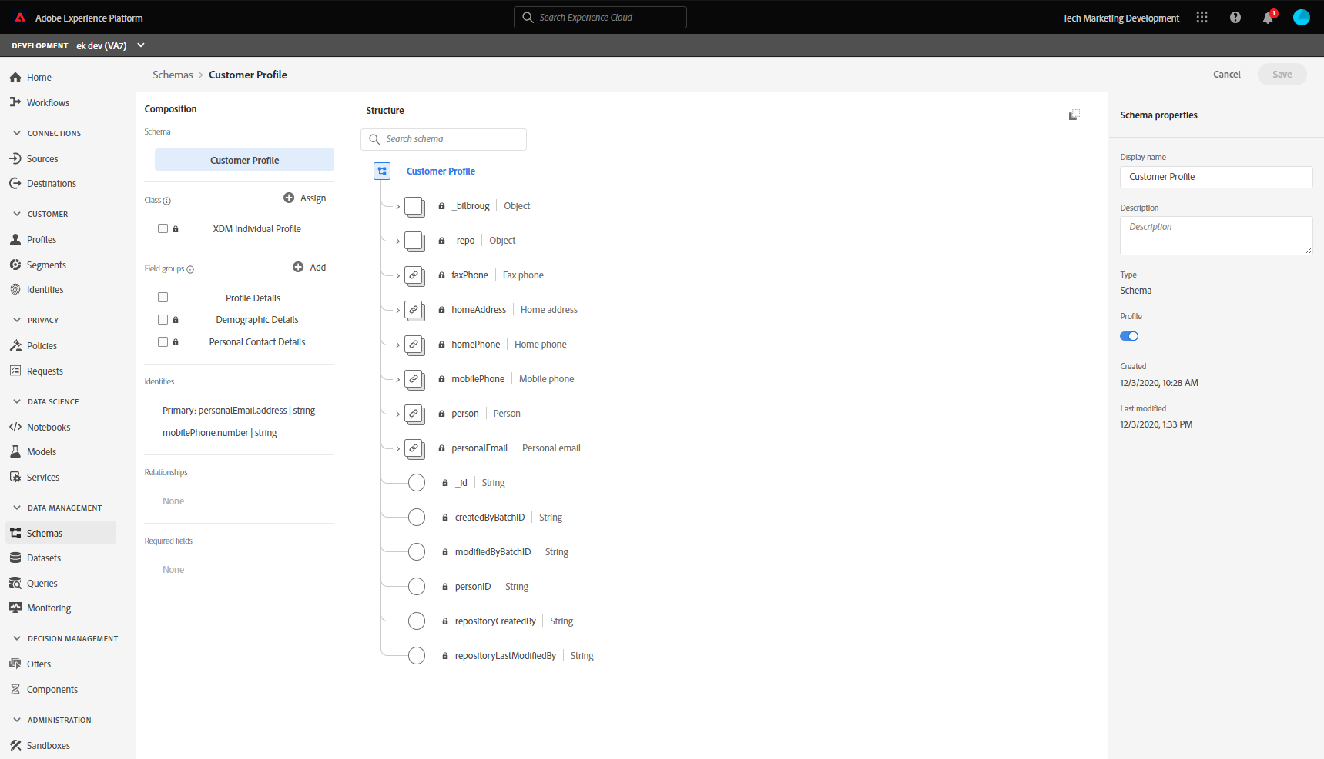
Schema composition
Behavior
Class
Field Group(s)*
Data Type
Record or Time Based
Individual vs. Experience
Collection of datatypes and fields
Collection of fields
Fields
Define a single field
Dataset Schema = Class + Field Group(s)*

Slide 11
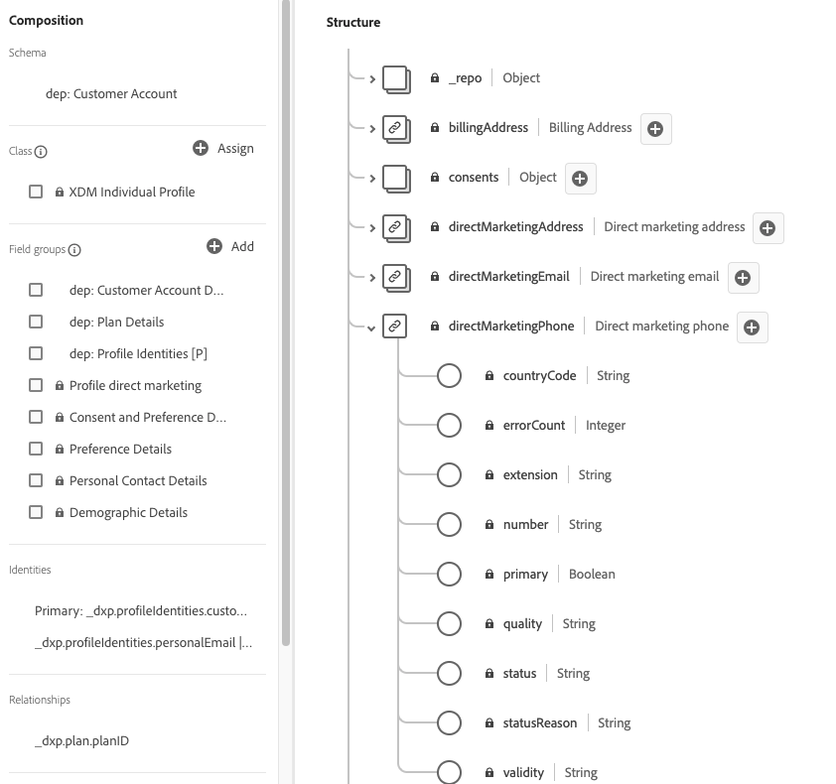
Schema Example

Slide 12
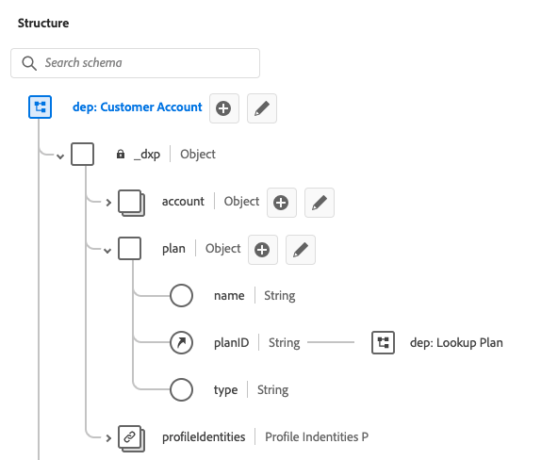
Tenant namespace

Slide 13
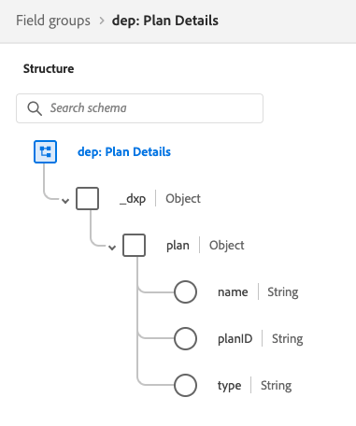
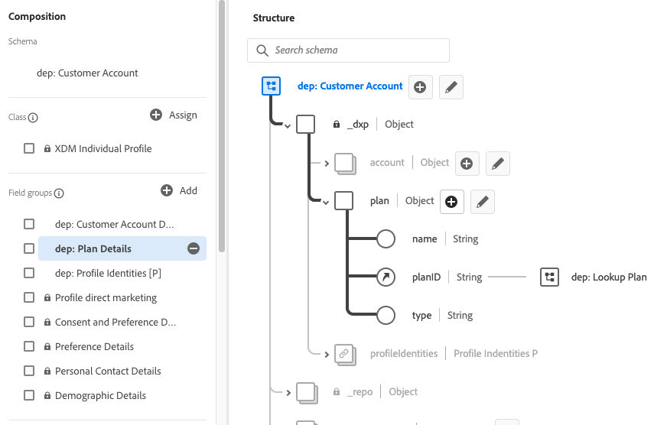
Field Groups (custom or standard)

Slide 14
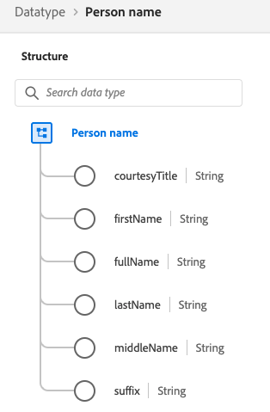
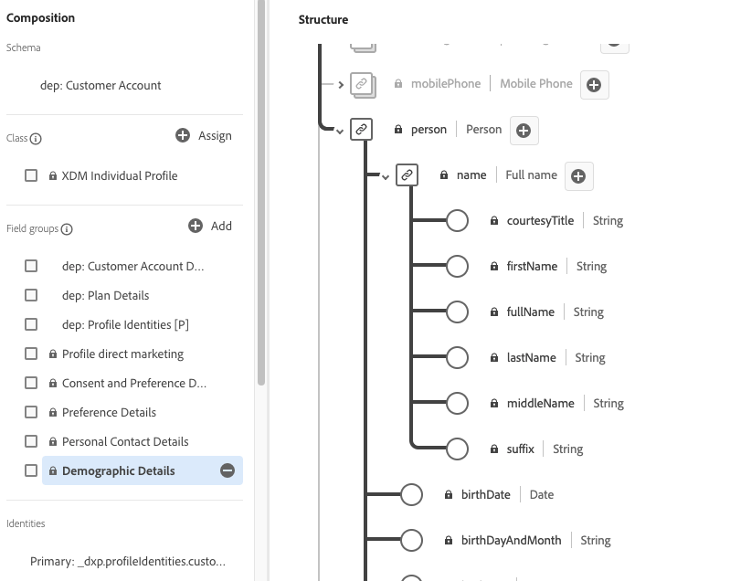
Data Type (custom or standard)

Slide 15
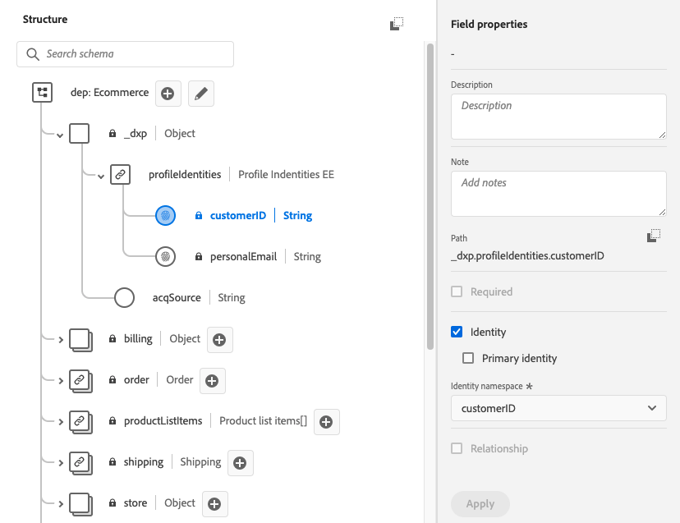
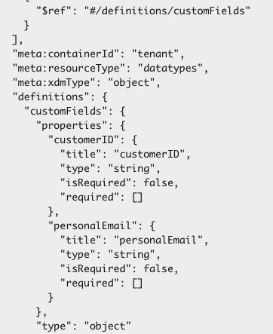
JSON & Dot Notation

Slide 16




XDM Descriptors
Descriptors are XDM system configurations applied to a field in a schema
Identity
Relationship
Friendly Name
Access Control
Assign an Identity Namespace to a field (Identity Descriptor)
Configure Schema relationships
(Relationship Descriptor)
Change the title of a standard field
(Alternate Display Descriptor)
Assign an Access Control label to a field
(Label Descriptor)

Slide 17
Identities
Namespace Types:
Email
Phone

Slide 18
Relationships

Slide 19
XDM Descriptors
Example JSON:
{
”@type”: “xdm:descriptorIdentity”, ”xdm:sourceSchema”: ”MyAEPSchema”,
“xdm:sourceProperty”: “/workEmail/adddress”,
”xdm:namespace”: “Email”
}

Slide 20
Schema Evolution Principles
If a field has been used to ingest data into Experience Platform, you may introduce a breaking change to that field. However, once the field has been used to ingest data, it must adhere to the additive versioning policy.
Supported Changes
Breaking Changes (not supported)
Adding new fields to existing schema
Making a mandatory field optional
Removing previously defined fields
Renaming or redefining existing fields
Removing or updating previously supported field values on enumerated fields
Moving fields to a different location in the schema tree
*UI will block UD operations to fields which belong to a schema that has a dataset attached, even if no data is ingested to those specific fields.

Slide 21
Remember this is what Profile will do?

Slide 22

UI Demo
Watch as I demo key constructs such as:
Browsing and selecting a class
Creating a new schema & giving it a name
Browsing standard field groups
Adjusting standard field group to only contain the fields I need
Extending a standard field group
Building a custom field group

Slide 23

Schema API Lab
Schema API Lab- Manik

Slide 24
In System Demo UI
Watch as I demo key constructs such as:
Browsing and selecting a class
Creating a new schema & giving it a name
Browsing standard field groups
Adjusting standard field group to only contain the fields I need
Extending a standard field group with custom fields
Building a custom field group
Create an enumerated field

Slide 25
Schema UI Lab
Schema UI Lab

Slide 26
Identities & Relationships

Slide 27
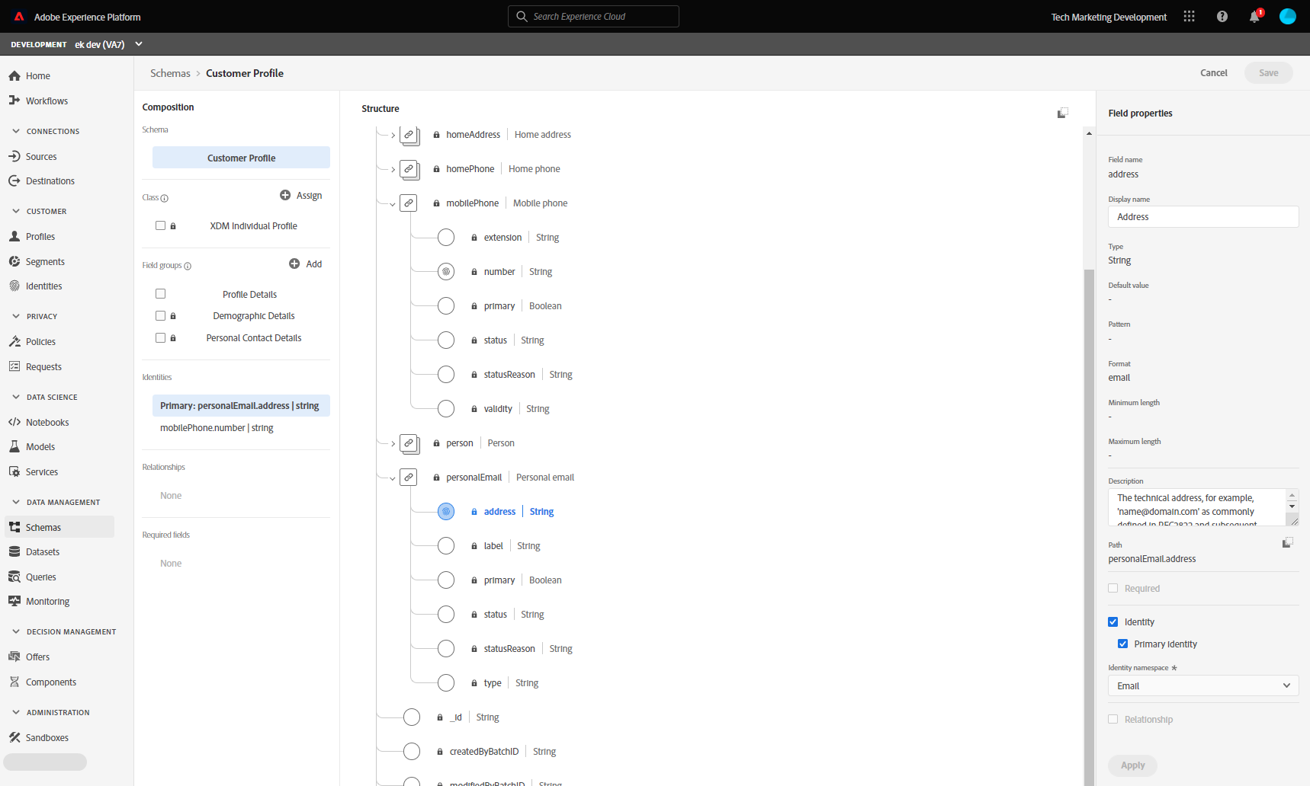
Identity Meta-Data
Key fields in a schema can be marked as “identities”
Primary vs. non-Primary Identity
A “Primary Identity” tells Profile how to reconcile/store profile fragments
Both “Primary” and “Non-Primary” identities are ingested into the Identity Graph
Two or more identity fields in a schema create a relationship within the Identity Graph

Slide 28
XDM Descriptors
Descriptors are XDM system configurations applied to a field in a schema
Identity
Relationship
Friendly Name
Access Control
Assign an Identity Namespace to a field (Identity Descriptor)
Configure Schema relationships
(Relationship Descriptor)
Change the title of a standard field
(Alternate Display Descriptor)
Assign an Access Control label to a field
(Label Descriptor)

Slide 29
Add content on identity namespace

Slide 30
Profile Identities vs IdentityMap

Slide 31
Composition Example
Schema Class
Commerce
Cart Value
Transaction ID (PI)
Loyalty ID (I)
DateTime
Products
Product Category
Product Category ID
Product Category Name
Field Group
Product [Product]
Product ID(PI)
Store Transactions [Experience Event]
Product Sub Category
Product Sub Category ID
Product Sub Category Name
Product Info
SKU
Color
Size
Personal Contact Details
Personal Email (PI)
Home Address (I)
Mobile Phone (I)
Web
Cookie ID (PI)
Loyalty ID (I)
Page ID
Page Name
Action
Customer
[Profile]
Web Visits [Experience Event]
Demographic Details
Name
Birth Date
Experience Event classes store data keyed using two values:
Event ID
Primary Identity
Product class and Profile Class data keyed using 1 value:
Primary Identity

Slide 32
Lookup Entity Relationships
Key
Schema Class
Provides the ability to define lookup tables to enrich segmentation experiences
Field Group
Loyalty Members [Individual Profile]
Loyalty Details
Level
Points
Member Since
Loyalty ID (PI)
Nearest Store
Store
Store ID (PI)
Location
Manager
Store Details [Store Details]
Note:
1:1 correlation between dimensional entity schema and dimensional entity dataset
Cached in memory so should remain light weight

Slide 34
In System Demo
Watch as I demo key constructs such as:
Marking an identity
Marking a primary identity
Building a relationship between profile & lookup tables

Slide 35
In System Demo
Do Lab on relationships in UI

Slide 36
Enabling for Profile & Union View
Notes:
https://experienceleague.adobe.com/docs/experience-platform/profile/union-schemas/union-schema.html?lang=en

Slide 37
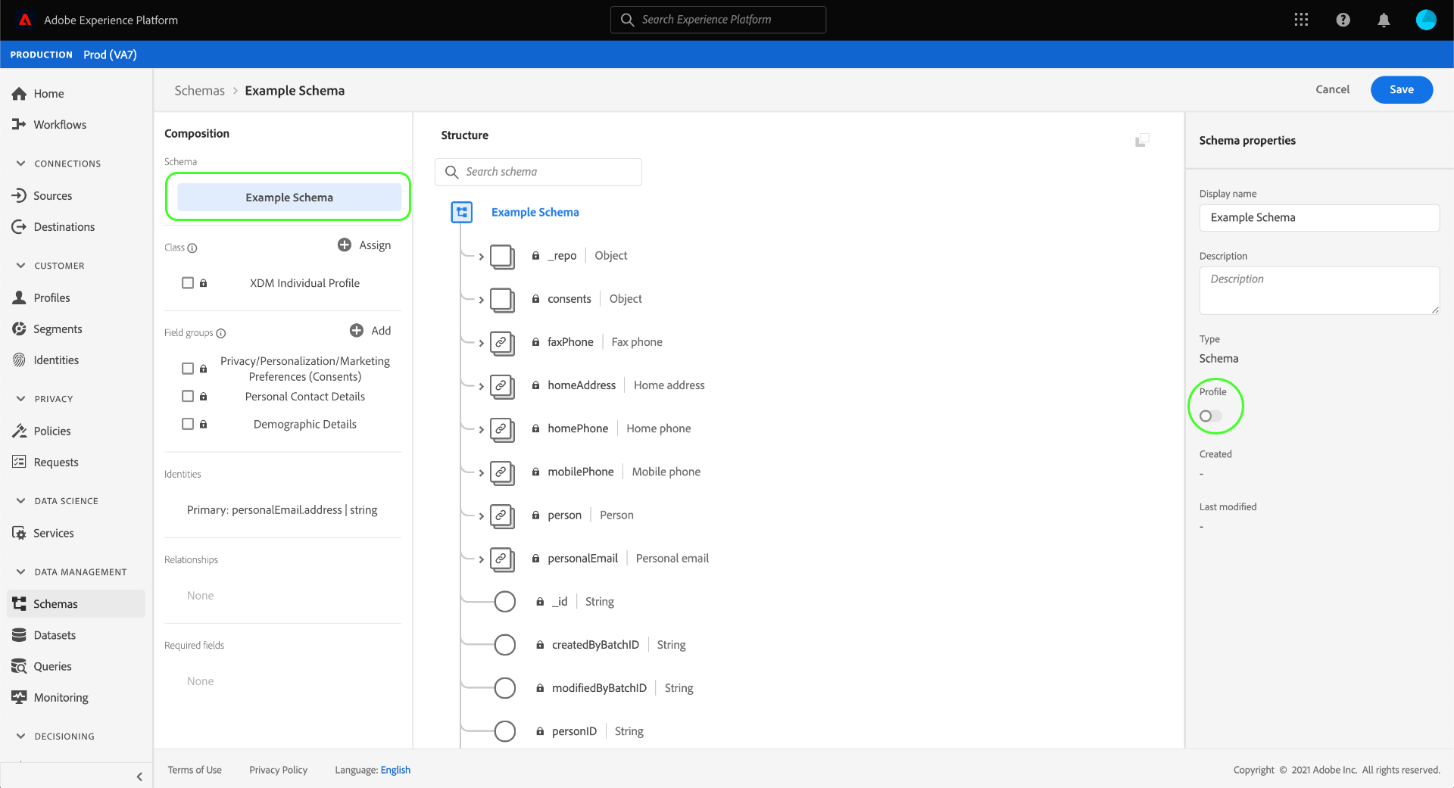
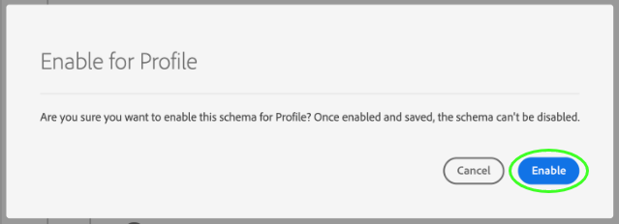
Enabling a schema for profile
RTCDP merges data from disparate sources to construct a complete view of each individual customer.
If you want the data captured by a schema to participate in this process, you must enable the schema for use in Profile.

Slide 38
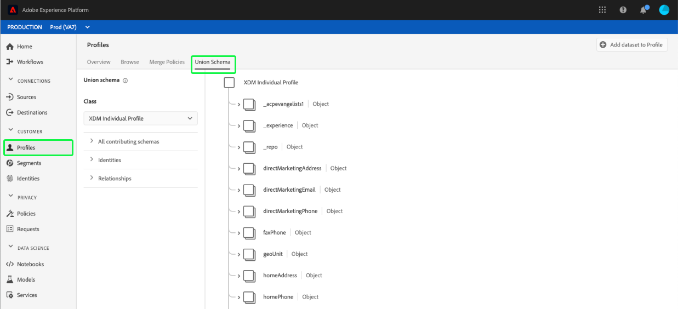
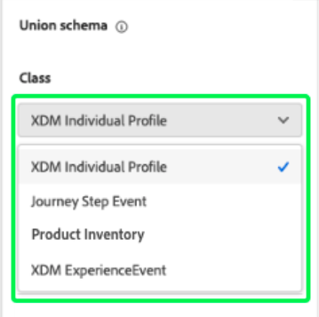
View Union Schema View
Union schema view gives a merged view of schemas belonging to a selected class

Slide 39
End
Notes:
https://experienceleague.adobe.com/docs/experience-platform/profile/union-schemas/union-schema.html?lang=en

